Slide 1
NMR and protein structure determination
Presented by Hélène Libion and Nicolas Potie

Slide 2
Outline
Introduction of essential concepts
Sequential steps for protein determination
CASD-NMR
Result of CASD-NMR2010 for 10 masked data sets
Softwares
Accuracy and convergence
Geometric and Stereochemical
Agreement with the data

Slide 3
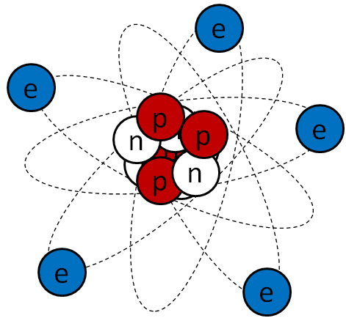
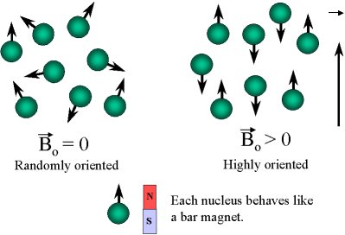
Nuclear spin
No magnetic field: nucleus cannot be distinguish by their spin.
With a magnetic field, some proton will align with field, are more stable (spin +1/2). Others align against the field and become less stable (spin -1/2) but have higher energy.
More intense are the magnetic field, more the difference of the two levels of energy is.

Slide 4


Slide 5
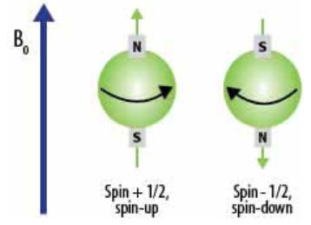
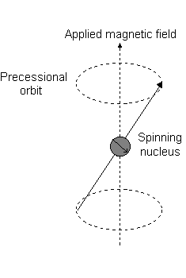
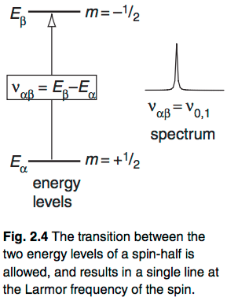
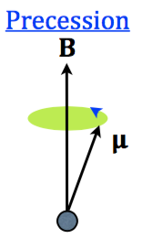
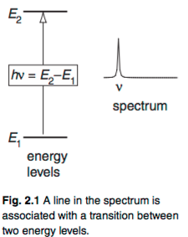
Nuclear spin and energy state

Slide 6
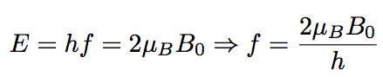
Energy and chemical shift
External magnetic field B0 to make nucleus spin up.
Apply a electromagnetic radiation at frequency f (radio frequency) can change state of nucleus. Thus they will jump to another energy state (=resonance) and will spin down (change of the frequency). It’s the chemical shift.
Each nucleus have different chemical shift, a different resonant frequency (Larmor frequency).
Unit: hertz

Slide 7
Chemical shift unit
Scientists use different experimental materials and conditions (different spectrometer, different B_0). Consequence? Not the same value of CS for a same molecule
So we want a standard way of comparing the same CS of the same molecule. That’s why we use PPM (Part Per Million) unit (instead of Hertz) in NMR

Slide 8
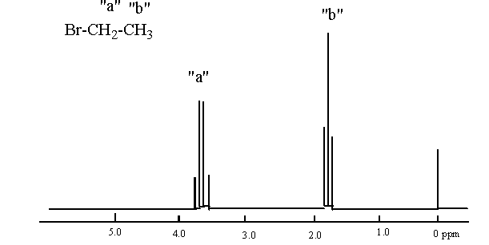
NMR spectrum
Describe the CS value of proton inside atoms.

Slide 9
Outline
Introduction of essential concepts
Sequential steps for protein determination
CASD-NMR
Result of CASD-NMR2010 for 10 masked data sets
Softwares
Accuracy and convergence
Geometric and Stereochemical
Agreement with the data

Slide 10
First step: resonance assignment
We know the resonant frequency of each different type of nucleus.
We apply the electromagnetic radiation at different given frequencies and see if some nucleus resonate. If so we know the type of the nucleus.
Find the chemical shift of every atom in the moleculue

Slide 11
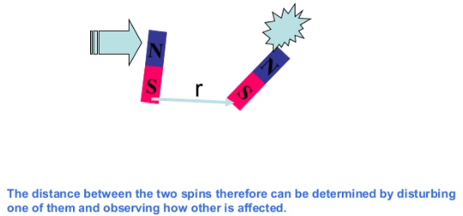
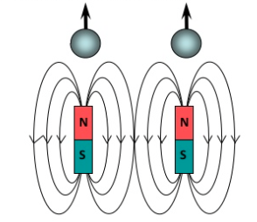
Nuclear Overhauser Effect (NOE)
Measure the change of intensity of one resonance when neighboring nucleus is perturbed
The local field at one nucleus is affected by the presence of the other. We have a mutual modulation of resonance frequency

Slide 12
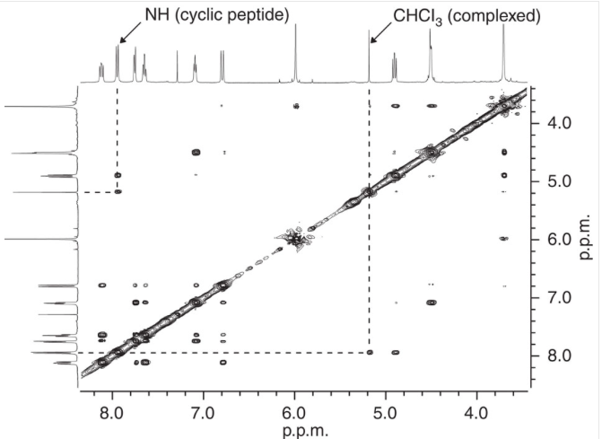
Nuclear Overhauser Effect Spectroscopy (NOESY)

Slide 13
Second step: NOESY assignment
Give conformational (interatomic) restraints .
It’s the interproton distance restraints.
Most important source of structural information: provide an indirect measure of the distances between the chemically abundant hydrogen nuclei (pairs of protons that are closer in space give rise to larger NOEs)
Capable of routinely producing a reliable high resolution structure

Slide 14
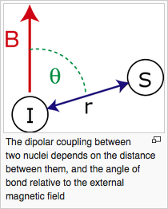
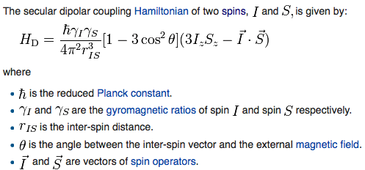
Additional conformational restraints
RDC: measurement of residual dipolar coupling(magnetic dipole-dipole interaction)

Slide 15
Third step: Structure generation
Software program generate a set of protein conformations (called bundle of conformers) that satisfy the experimental restraints (NOESY)

Slide 16
Fourth step: The structure refinement
The bundle of conformers is refined through restrained molecular dynamics simulations

Slide 17
Outline
Introduction of essential concepts
Sequential steps for protein determination
CASD-NMR
Result of CASD-NMR2010 for 10 masked data sets
Softwares
Accuracy and convergence
Geometric and Stereochemical
Agreement with the data

Slide 18
Critical assessment of Automated Structure Determination of protein by NMR
Aim: assignment whether assessing methods that address the NOESY assignment, structure generation, structure refinement step can produce protein structures that closely match the structures manually determined by experts using the same experimental data

Slide 19
Outline
Introduction of essential concepts
Sequential steps for protein determination
CASD-NMR
Result of CASD-NMR2010 for 10 masked data sets
Softwares
Accuracy and convergence
Geometric and Stereochemical
Agreement with the data

Slide 20
Softwares
3 categories :
Using NOESY data
Using CS data augmented by NOESY
Using CS data

Slide 21
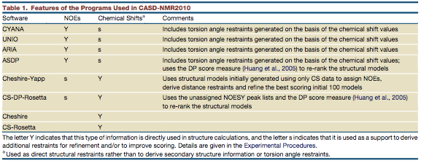
Softwares

Slide 22
Results
3 kind of quality structure validation
Accuracy and convergence
Geometric and stereochemical
Agreement with data

Slide 23
Accuracy and convergence
RMSD (Root Mean Square Deviation)
GDT_TS (Global Distance Test Total Score)
Acceptable structure
RMSD ≤ 2Å and GDT_TS ≥ 80%

Slide 24
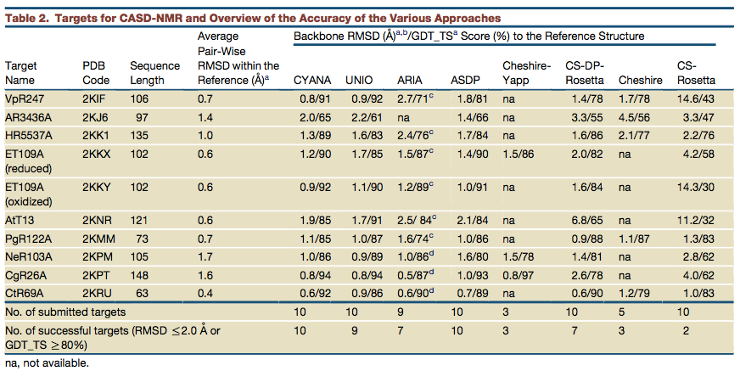
Results of the programs

Slide 25
Conclusion
NOESY-based program
CYANA, UNIO and ASDP = 100 %
ARIA = 80 %
CS augmented by NOESY
Cheshire-Yapp runned on three targets
CS-RD-Rosetta = 70%
Pure CS
The poorest performance

Slide 26
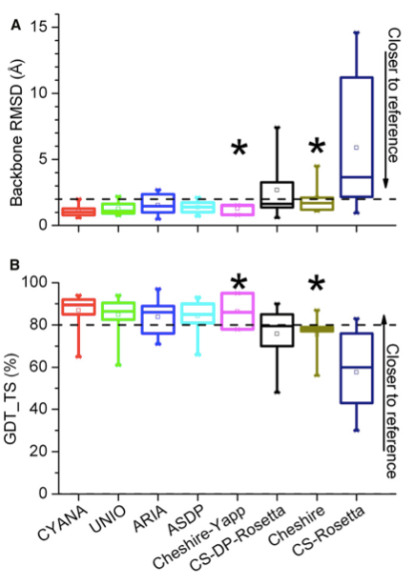

Slide 27
Results of the targets

Slide 28
Results of the targets

Slide 29
Other measure of accuracy
Mean RMSD
Comparison with an independent structure

Slide 30
Geometric and Stereochemical
PSVS (Protein Structure Validation Software)
Secondary structure element
Ordered residues
RMSD values for all and ordered residues
Ramachandran plot for ordered residues
global quality score for Verify3D, Prosall, Procheck(phi-psi), Procheck(all) and MolProbity clash
RPF score

Slide 31
Geometric and Stereochemical
CING (Common Interface for NMR structure Generation)
biomolecular structure
CS, distance restraints
dihedral angle restraint
RDC restraint
NMR peak

Slide 32
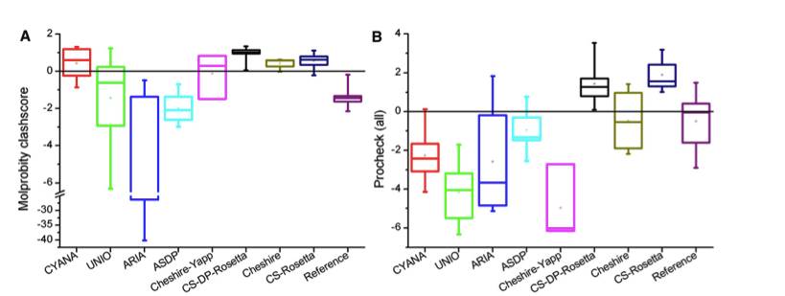
Procheck(all) and MolProbity clash

Slide 33
Agreement with the data
DP-score (Discriminating Power score)
Acceptable structure
DP-score ≥ 0.7
Correlation with accuracy

Slide 34
